Slide 1

Actuators
BIOE 3090

Slide 2
Announcements
3D Printing Module Graded
Renderings / Drawings / Screenshots of Isometric Views
Drawing standards
User needs -> Requirements
Requirements
Activity on Day 3

Slide 3

This Module
Actuators, Micropumps, Arduino

Slide 4
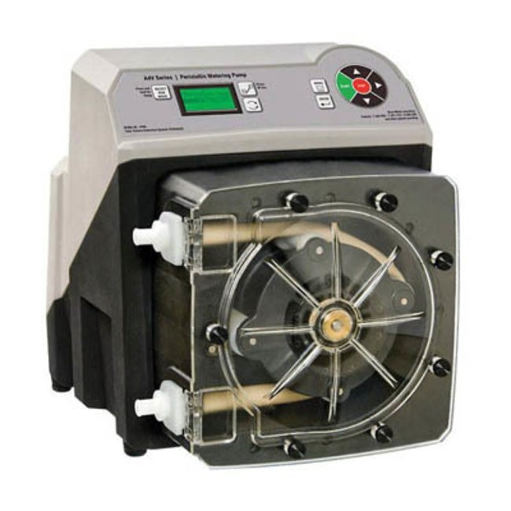
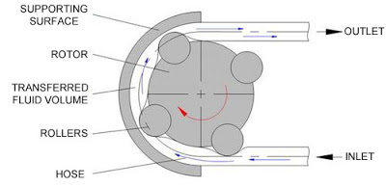
Peristaltic Pump

Slide 5

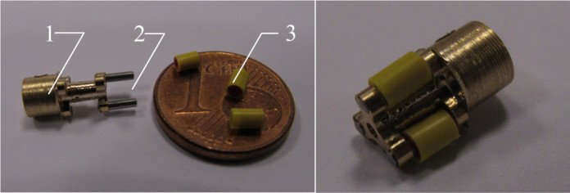
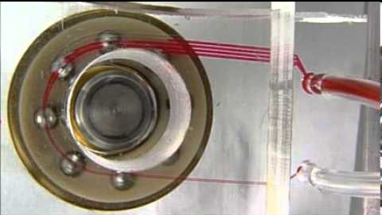
Micropumps Examples

Slide 6
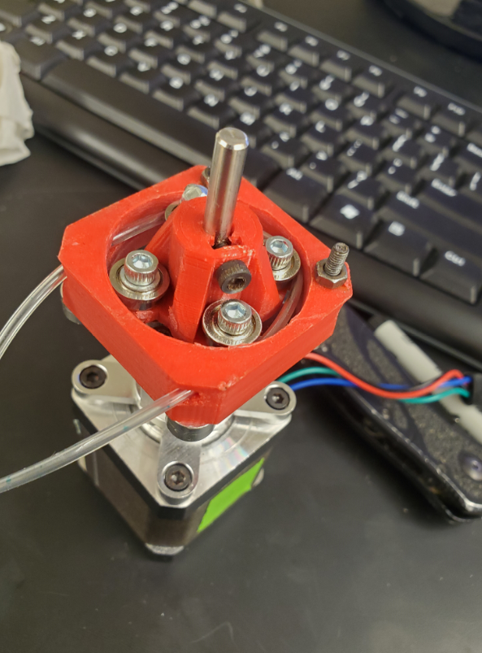
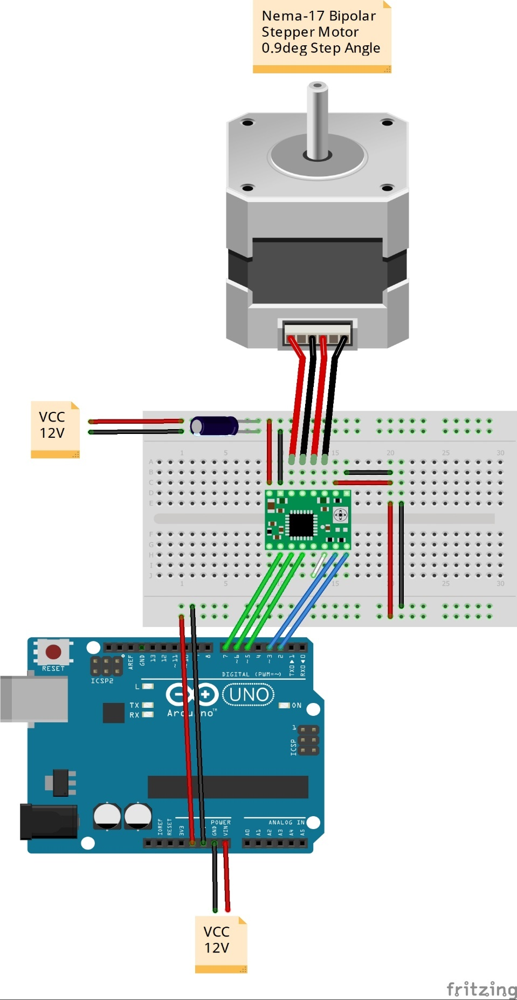
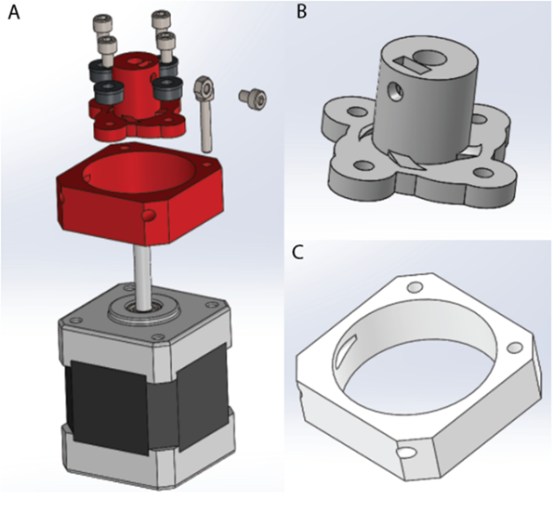
Micropump - Ours

Slide 7
Actuators Module Outline
Canvas
Actuators and Component Selection Module

Slide 8

Micropump Control?
Notes:
How would you propose controlling this micropump?

Slide 9
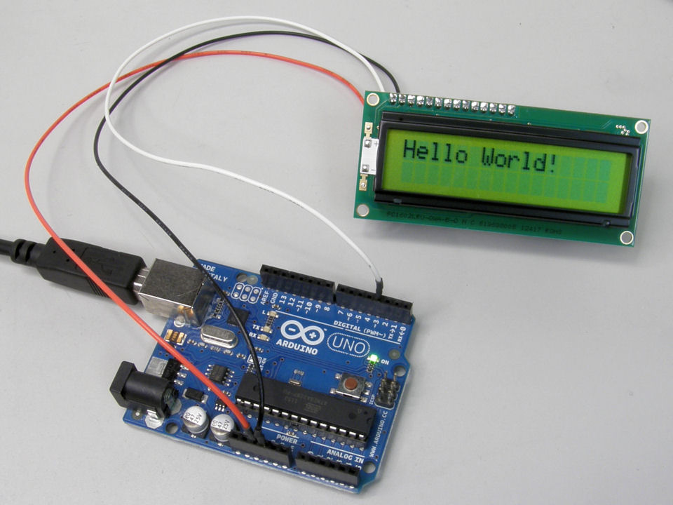
Arduino
Notes:
What is an Arduino? When should I use an Arduino? How is an Arduino programmed?

Slide 10

ARDUINO - IDE
WHAT IS AN IDE?
WHY USE AN IDE?

Slide 11
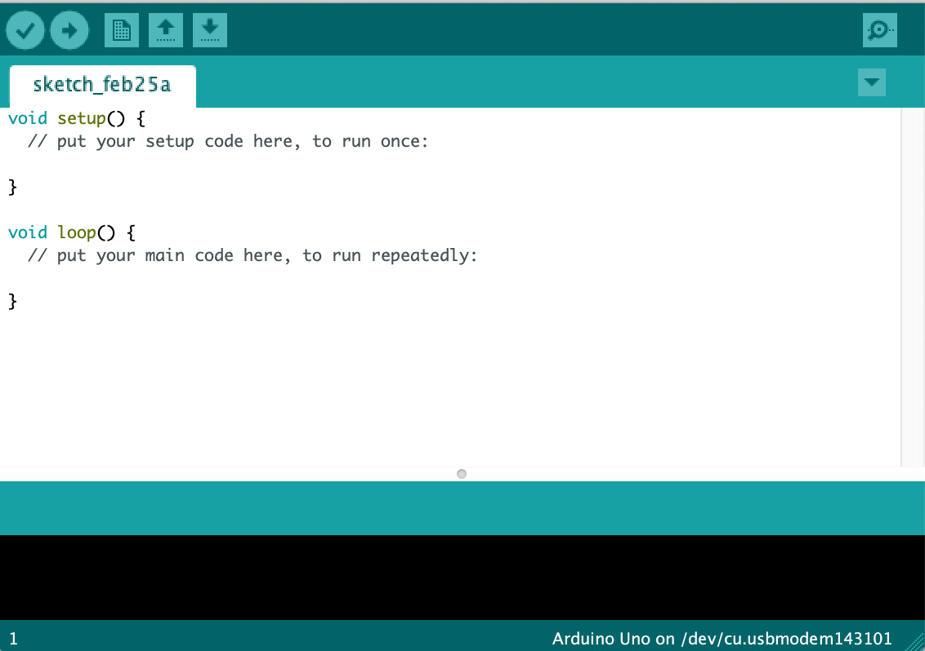
ARDUINO IDE
Integrated
Development
Environment

Slide 12
ARDUINO IDE
Setup

Slide 13
ARDUINO IDE
Main Loop

Slide 14
ARDUINO IDE
Compile and Run
Compile

Slide 15
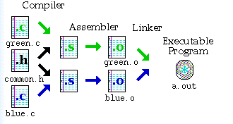
Compile?

Slide 16
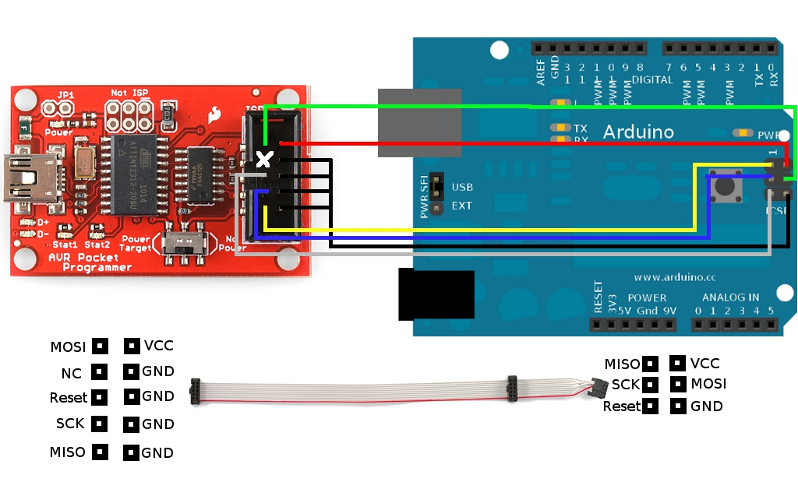
Bootloader

Slide 17
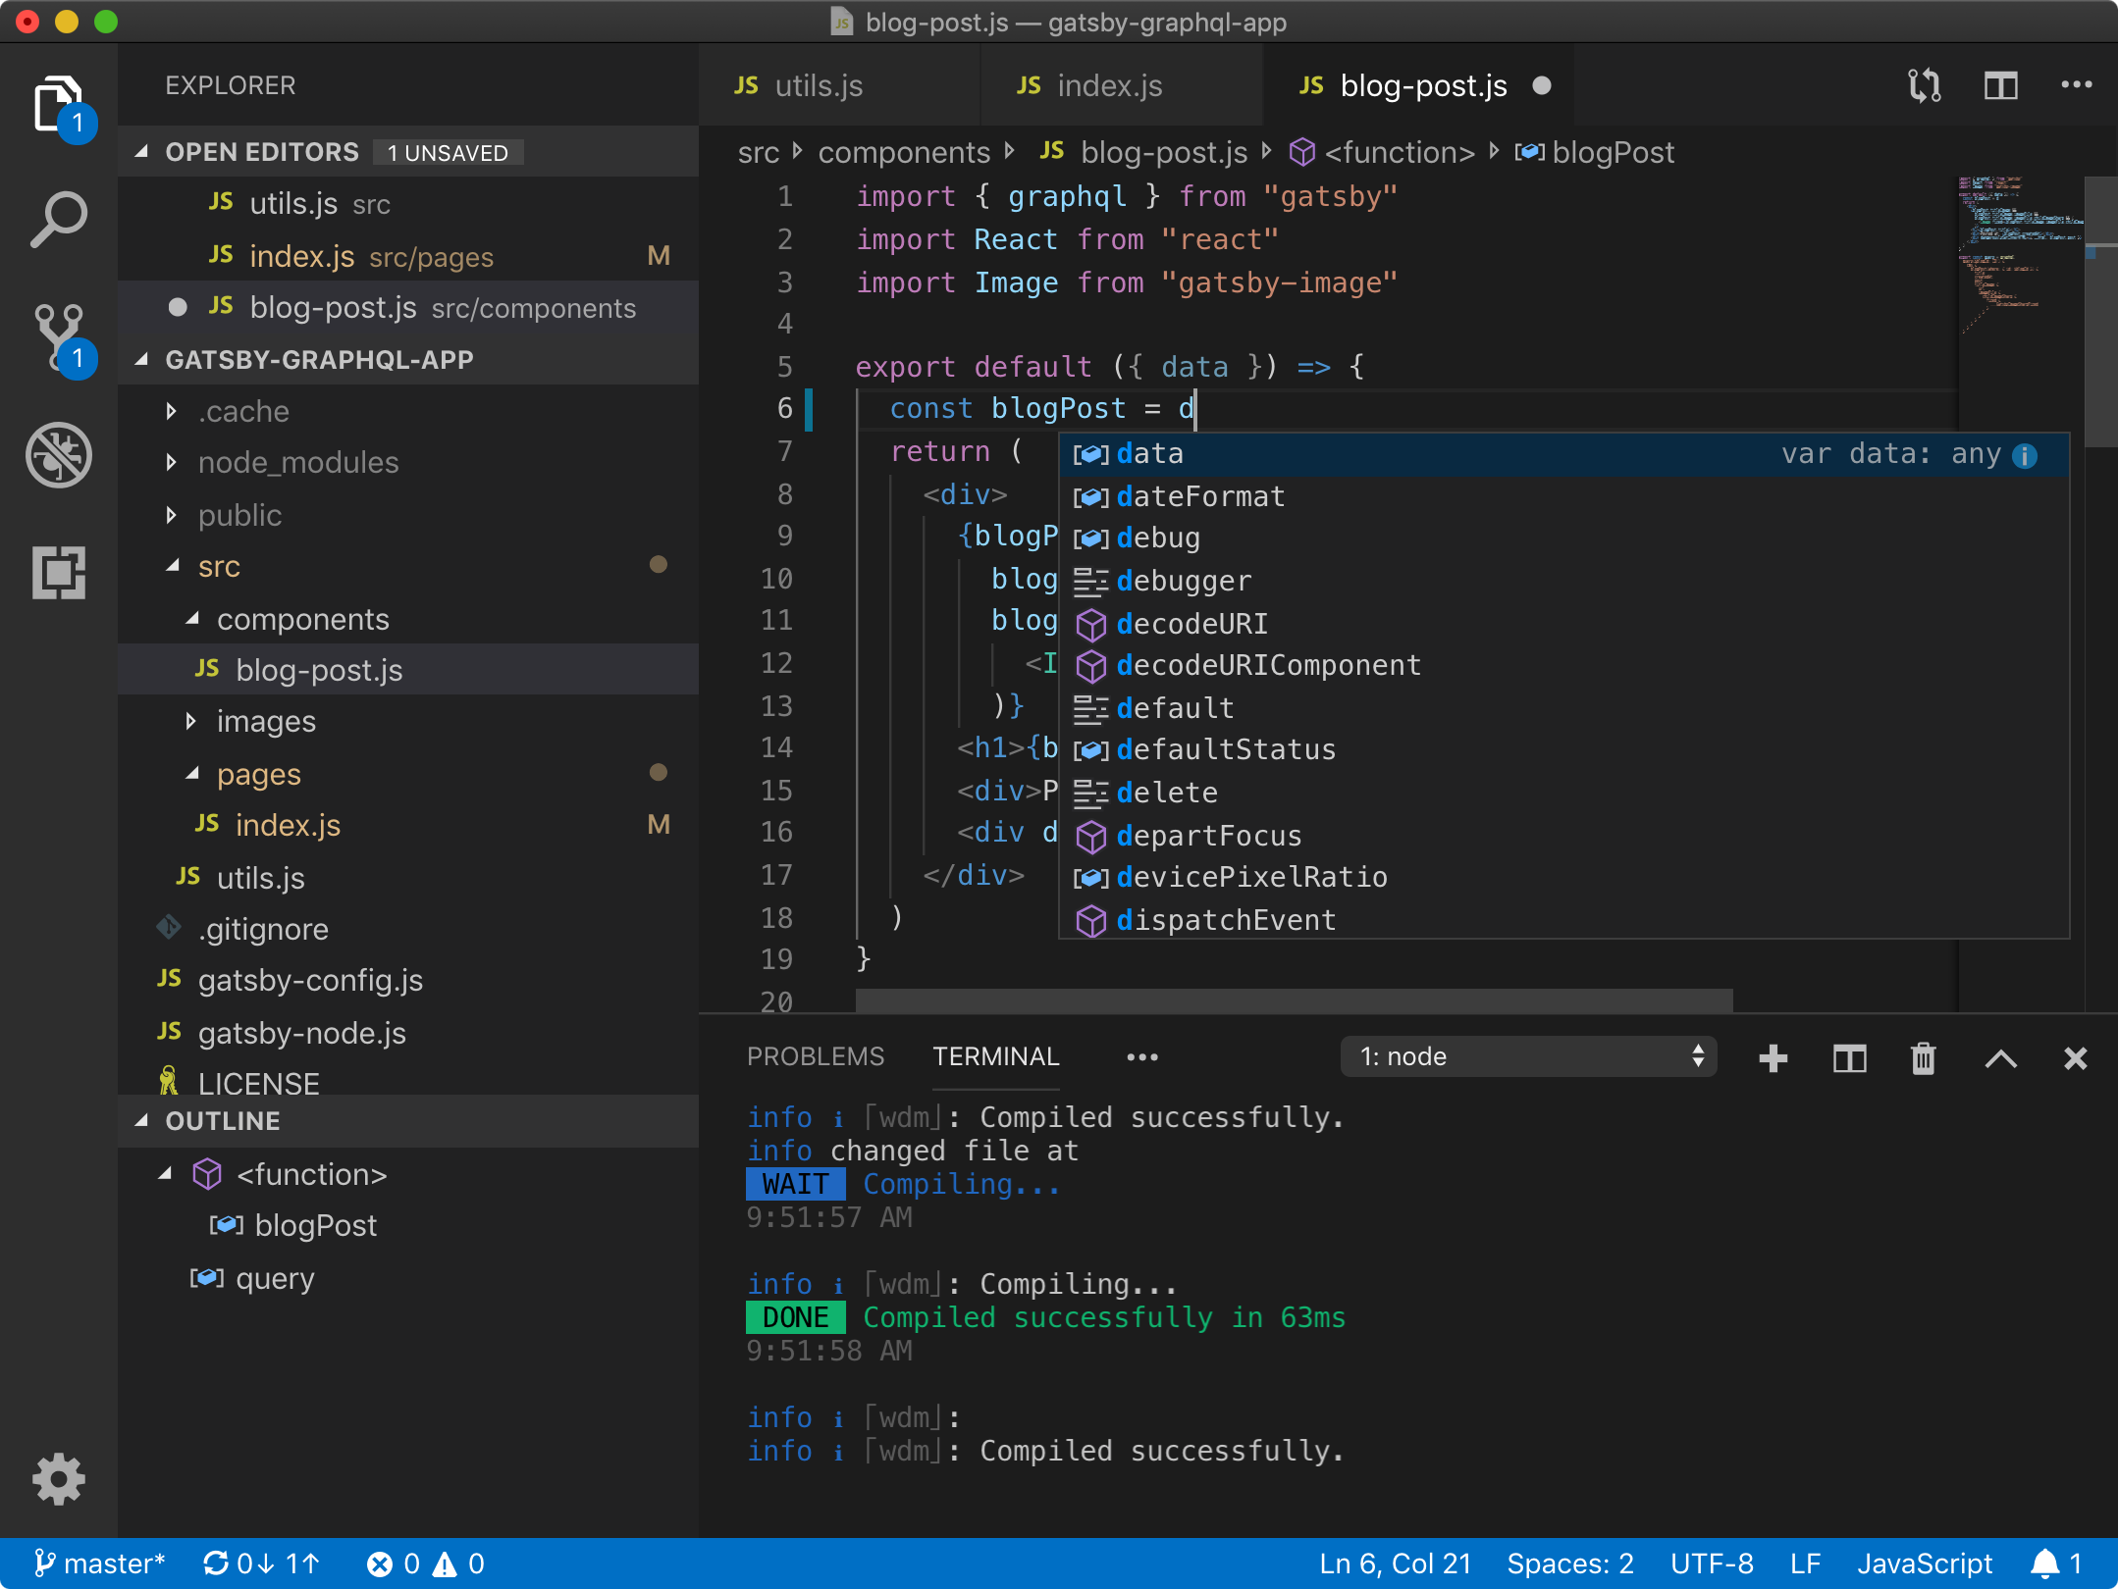
IDE ALTERNATIVES
VS-Code
Notepad ++
Emacs
Vim
Atom

Slide 18
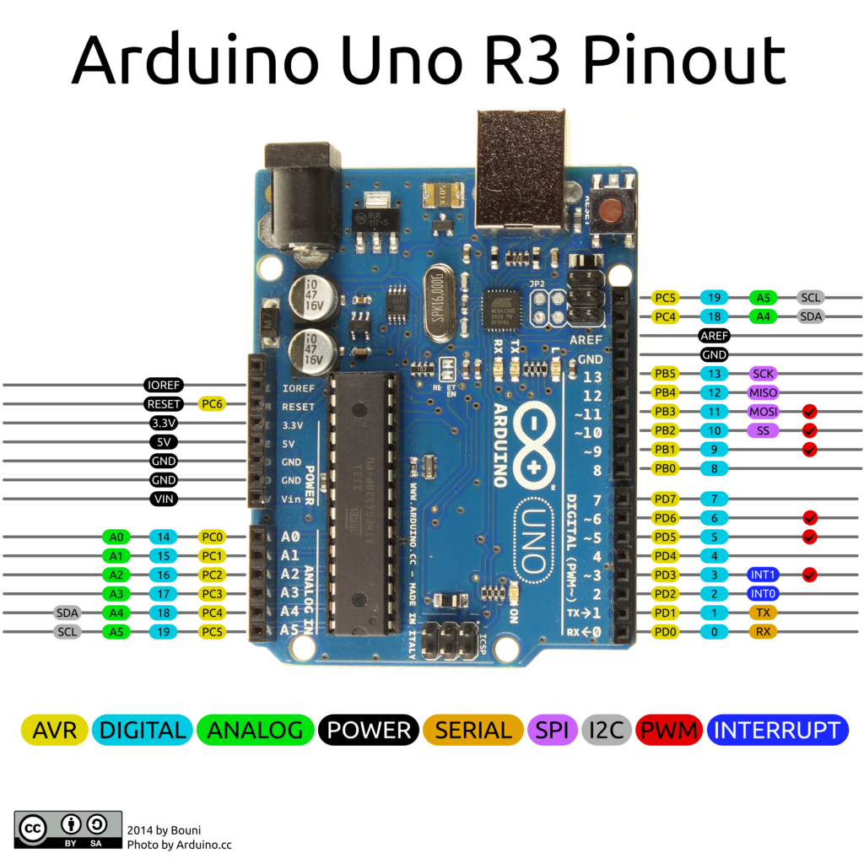
Pinout

Slide 19

Activity 1 – Anatomy of the Board

Slide 20

Arduino Programming ≠ Script Kiddie

Slide 21
Flowchart Pseudocode
Direction and order of program execution
Beginning | end
Of program
Comment statements
Point where input| output from program
Beginning of a repetition.
Assignment of value to a variable | constant. May be result of computation (Include in rect.)
Algorithm specified outside program
Point where decision is made
Combine flow lines
https://www.owlnet.rice.edu/~ceng303/manuals/fortran/FOR3_3.html

Slide 22
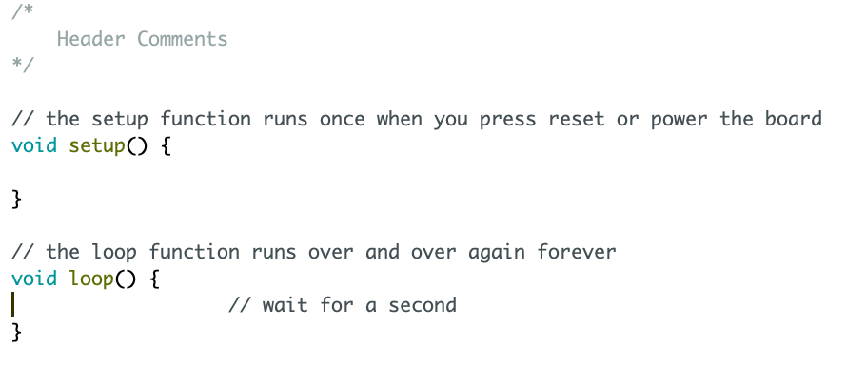
Program Flowchart
Begin
Setup
Loop

Slide 23
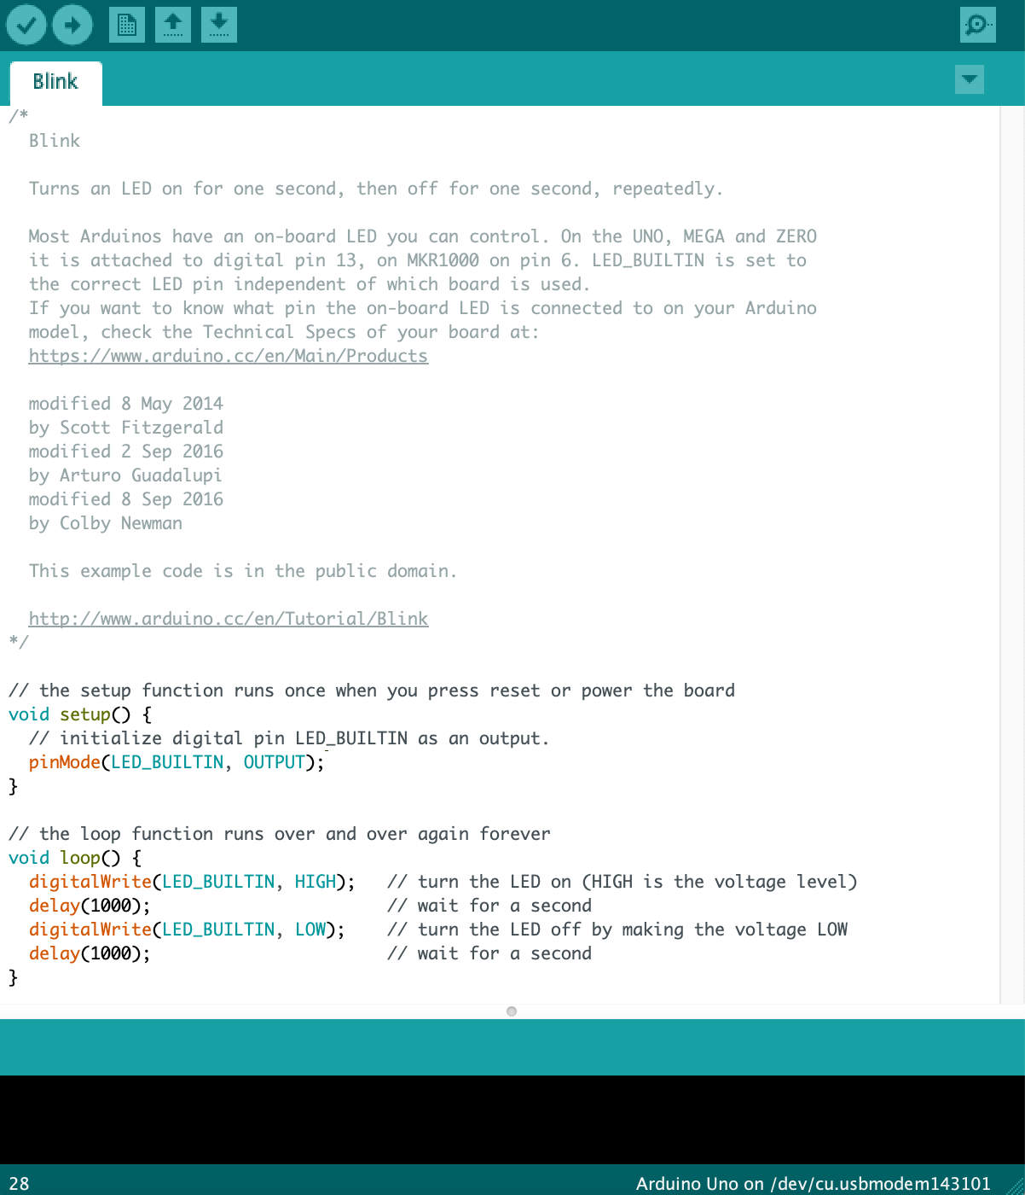
Comments
Header Comment

Slide 24
Header Comment
/*
Blink
Turns an LED on for one second, then off for one second, repeatedly.
Most Arduinos have an on-board LED you can control. On the UNO, MEGA and ZERO
it is attached to digital pin 13, on MKR1000 on pin 6. LED_BUILTIN is set to
the correct LED pin independent of which board is used.
If you want to know what pin the on-board LED is connected to on your Arduino
model, check the Technical Specs of your board at:
https://www.arduino.cc/en/Main/Products
modified 8 May 2014
by Scott Fitzgerald
modified 2 Sep 2016
by Arturo Guadalupi
modified 8 Sep 2016
by Colby Newman
This example code is in the public domain.
http://www.arduino.cc/en/Tutorial/Blink
*/
/*
Blink_3090
Turns an LED on for one second, then off for one second, repeatedly.
Pin 13 – Digital out: LED
created 25 Feburary 2020
by Steve Lammers
This example code is in the public domain.
Source code adapted from - http://www.arduino.cc/en/Tutorial/Blink
*/

Slide 25
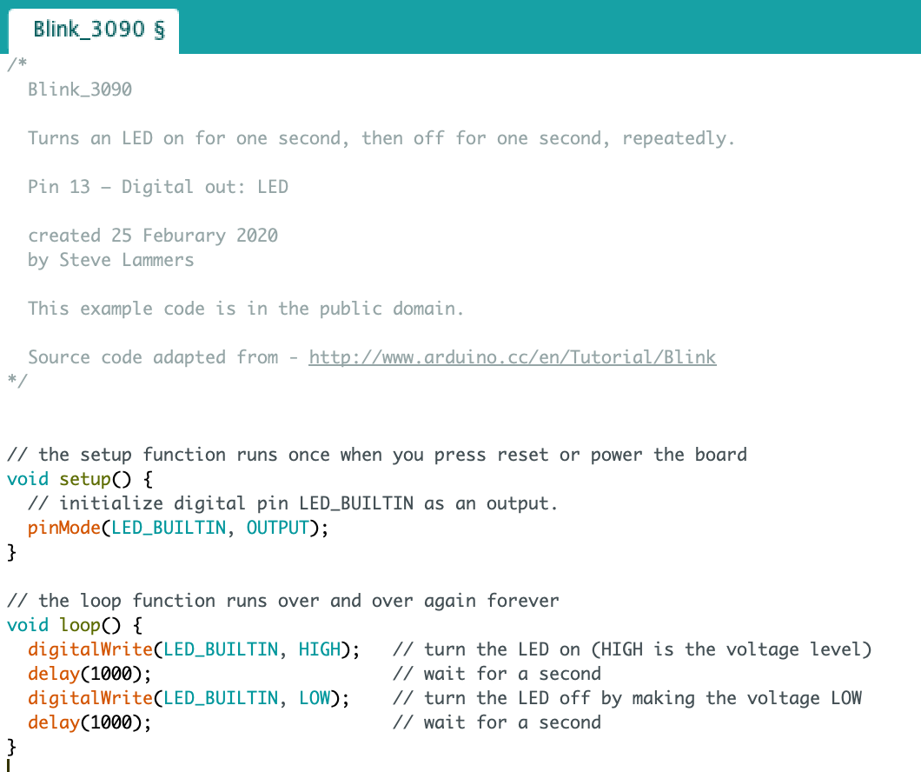
Comments
Function Comment

Slide 26
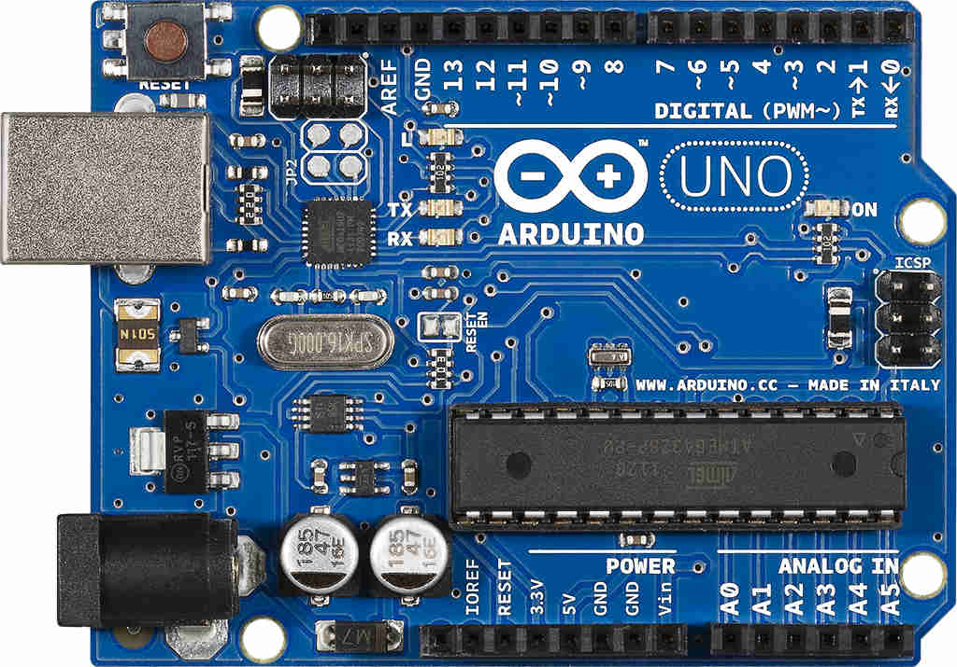
pinMode
pinMode(LED_BUILTIN, OUTPUT);

Slide 27
Activity 2 – Blink

Slide 28
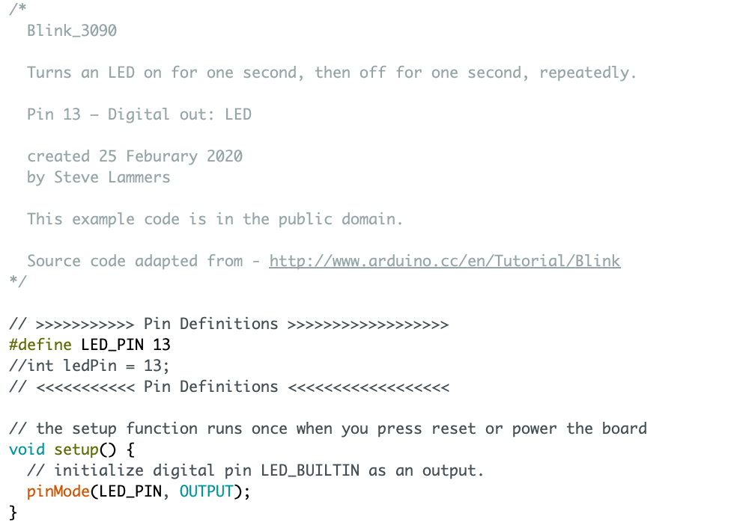
Pin Definitions
#define identifier token-string
OR
int ledPin = 13;
Section Comment

Slide 29


Debugging

Slide 30
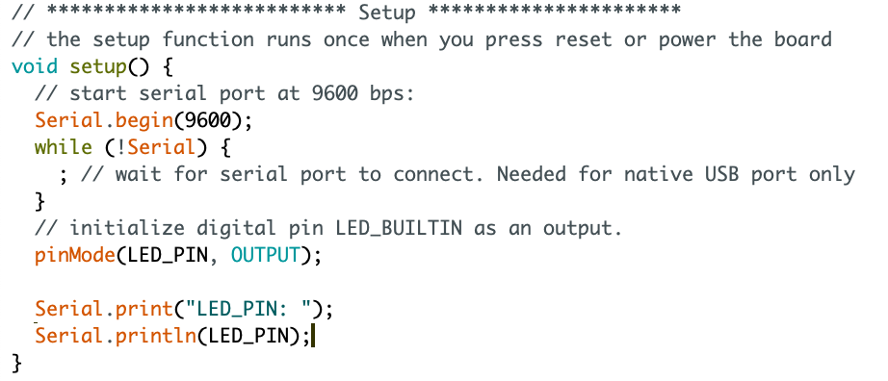
Print Statements

Slide 31
Testing
Unit Testing
Ad-hoc Testing

Slide 32
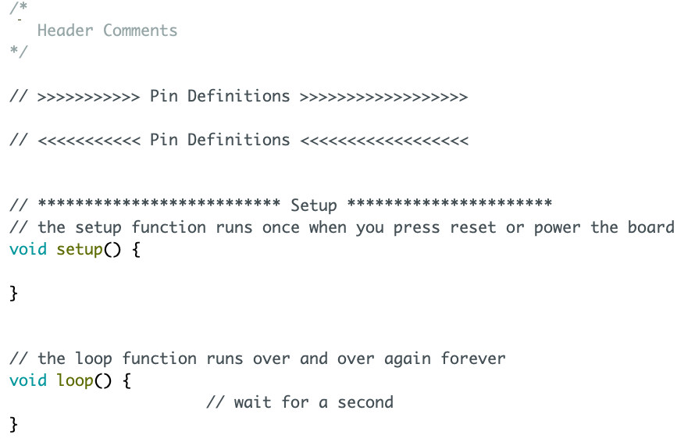
Current Program Flowchart
Begin
Pin Definitions
Setup
Loop

Slide 33
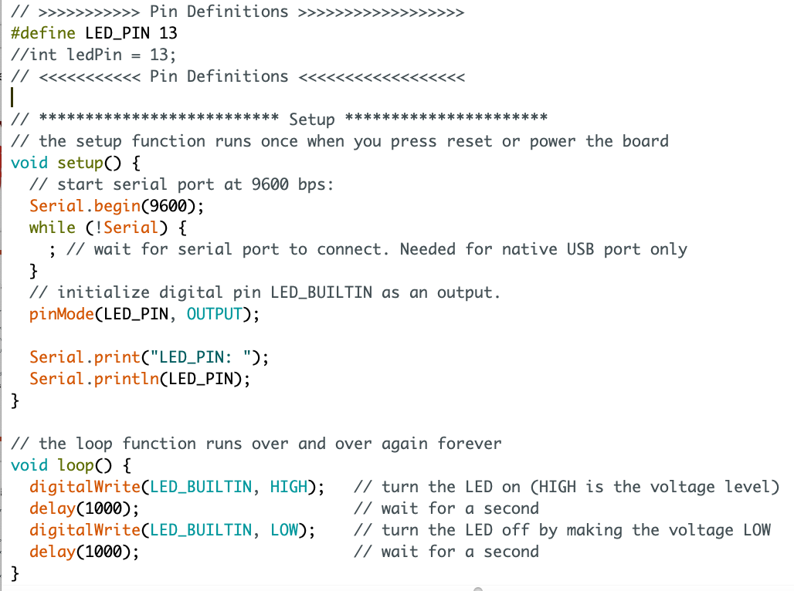
Main Loop – Functional Programming
Add This
Change This
Functionalize This

Slide 34
Activity 3 – Simplify the Main Loop

